Slide 1
Introduction to Computer Vision
6. Haar cascade. Histogram of oriented gradients for object classification & detection.
21.11.22
Mikhail Belyaev

Slide 2
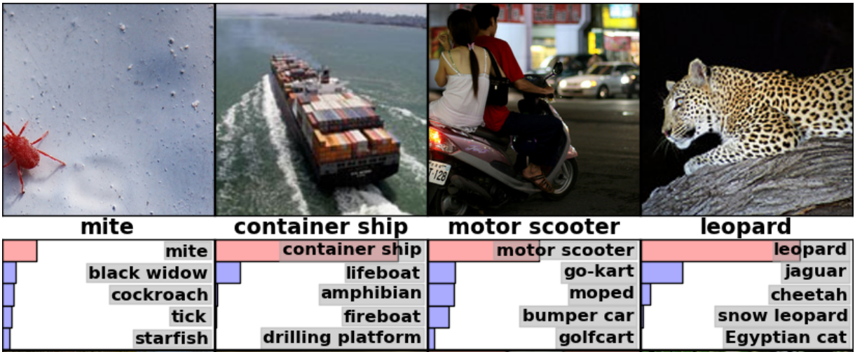
CV problems: Image Classification
Image source: Krizhevsky et al. ImageNet Classification with Deep Convolutional Neural Networks

Slide 3
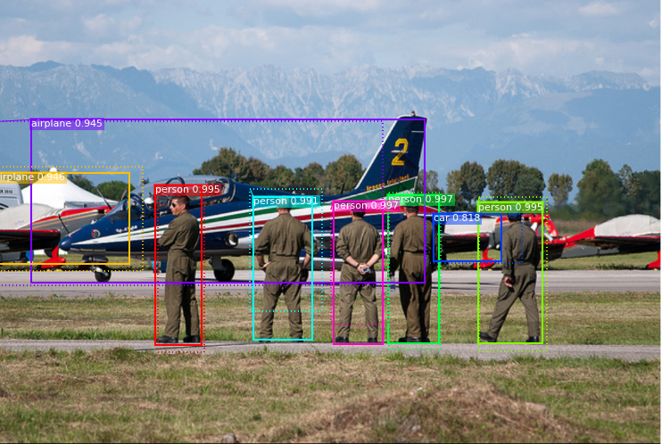
CV problems: Object detection
Image source: https://github.com/matterport/Mask_RCNN

Slide 4
CV problems: Object detection
Please name methods from previous lectures to detect objects
Image source: https://github.com/matterport/Mask_RCNN

Slide 5
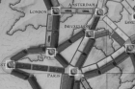
CV problems: Object detection
Please name methods from previous lectures to detect objects. We know even two!
Template matching
Contours
https://www.pyimagesearch.com/2014/11/10/histogram-oriented-gradients-object-detection/

Slide 6
CV problems: Object detection
Please name a method from previous lectures to detect objects. We know even two!
Template matching
Contours
What are the limitations of these two methods?
Too strict requirements!
Exactly the same or simple shape
Preferably the same size
Preferably the same lightness
https://www.pyimagesearch.com/2014/11/10/histogram-oriented-gradients-object-detection/

Slide 7
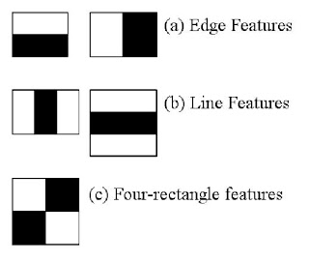
Haar cascade
https://opencv-python-tutroals.readthedocs.io/en/latest/py_tutorials/py_objdetect/py_face_detection/py_face_detection.html
Step 1: convolve the image with these predefined filters (black=-1, white=1). Then flatten the convolved image to get a huge number if features

Slide 8
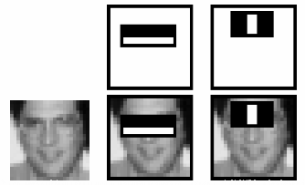
Haar cascade
https://opencv-python-tutroals.readthedocs.io/en/latest/py_tutorials/py_objdetect/py_face_detection/py_face_detection.html
Step 2: estimate quality of fit (in terms of classification error) for every single feature separately.

Slide 9
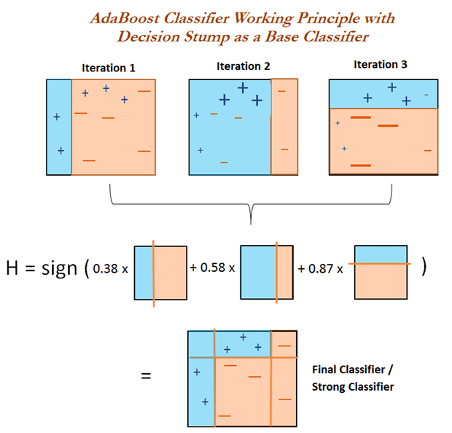
Haar cascade
Viola, P. and Jones, M. Rapid object detection using a boosted cascade of simple features. CVPR 2001.
Just 200 features is needed to get 95% accuracy for face classification!
Step 3: use adaboost to create a strong classifier from a huge set of weak ones

Slide 10
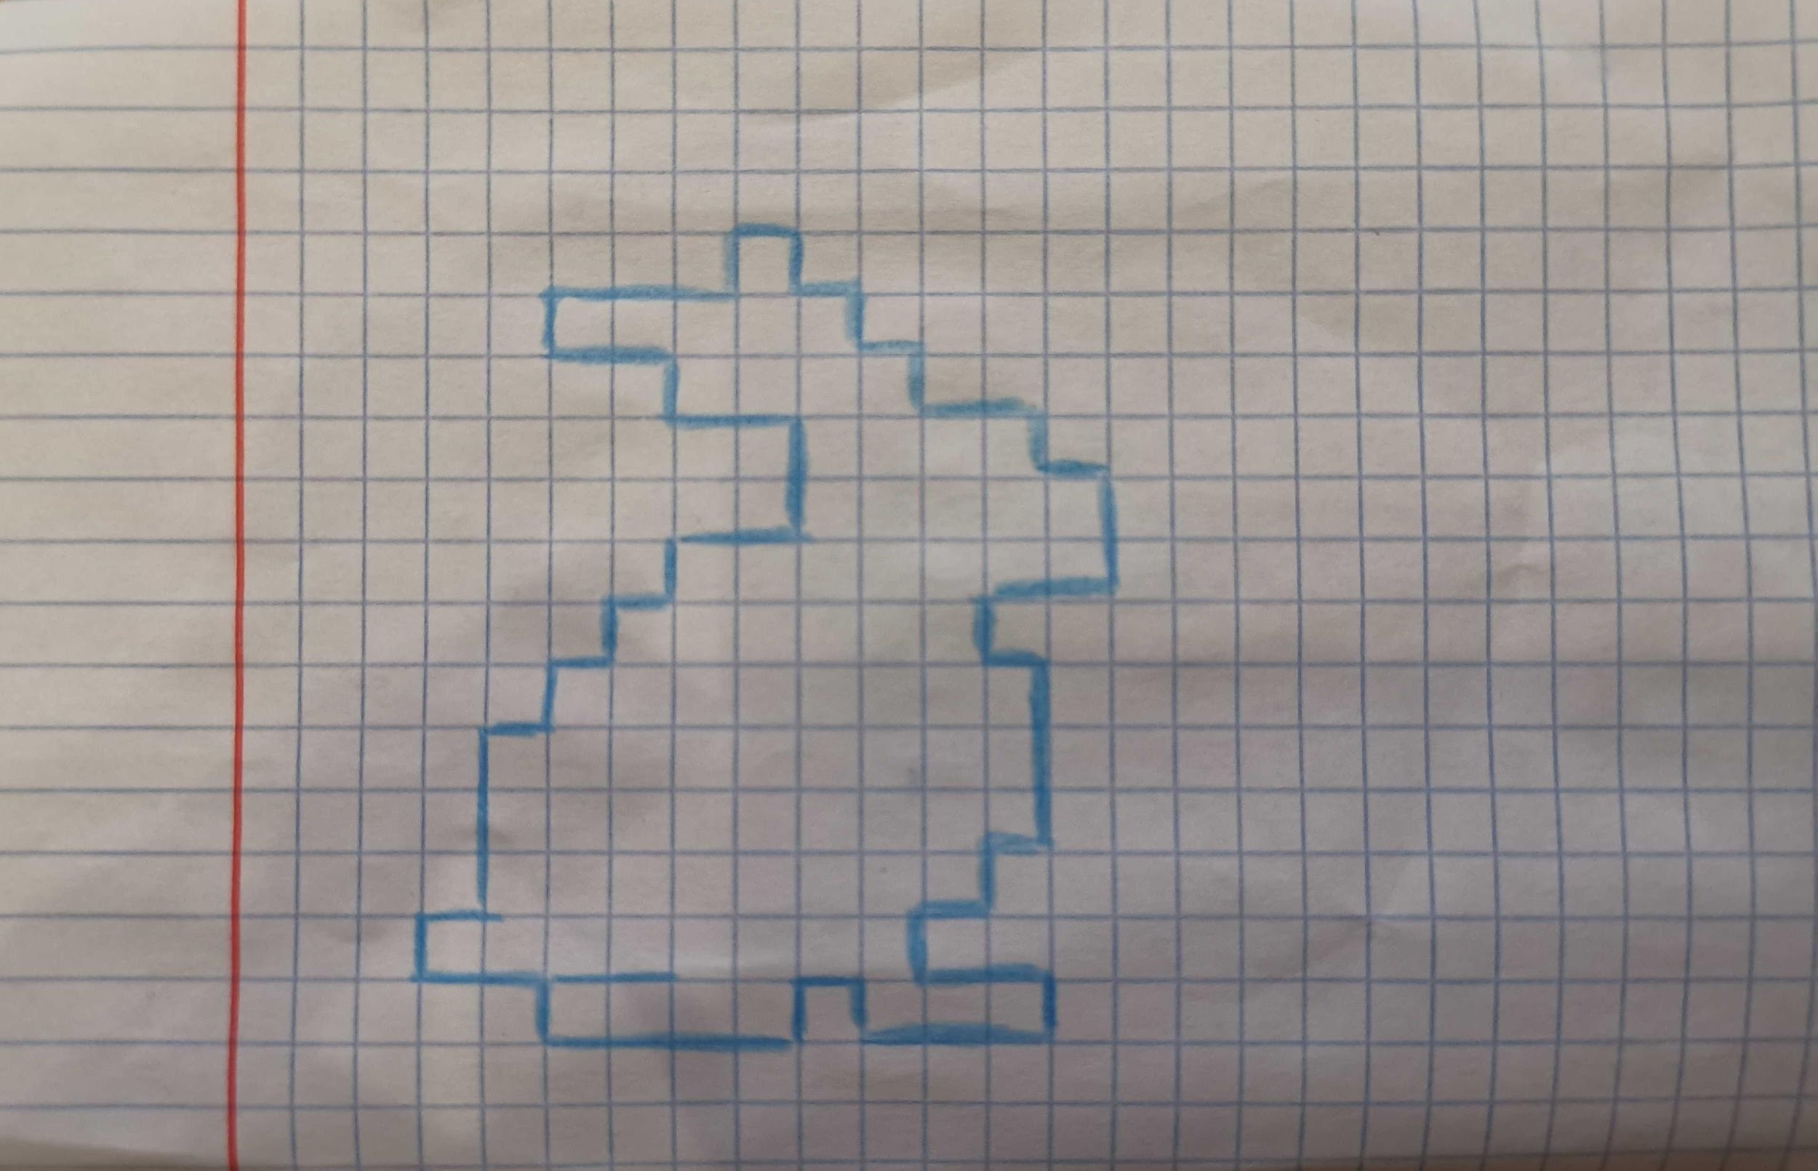
Histogram of Oriented Gradients
We are able to recognize objects based on edges. Let us try to teach the machine!

Slide 11
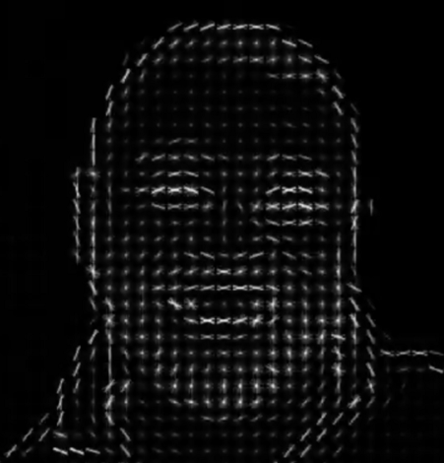
Histogram of Oriented Gradients
The core idea: local object appearance and shape can often be characterized rather well by the distribution of local intensity gradients or edge directions.
Gradient orientation is a way to create a simple digital representation of an edge
Some ideas are close to Canny edge detector
Dalal, N. and Triggs, B. Histograms of oriented gradients for human detection. CVPR 2005.
https://medium.com/analytics-vidhya/a-take-on-h-o-g-feature-descriptor-e839ebba1e52

Slide 12
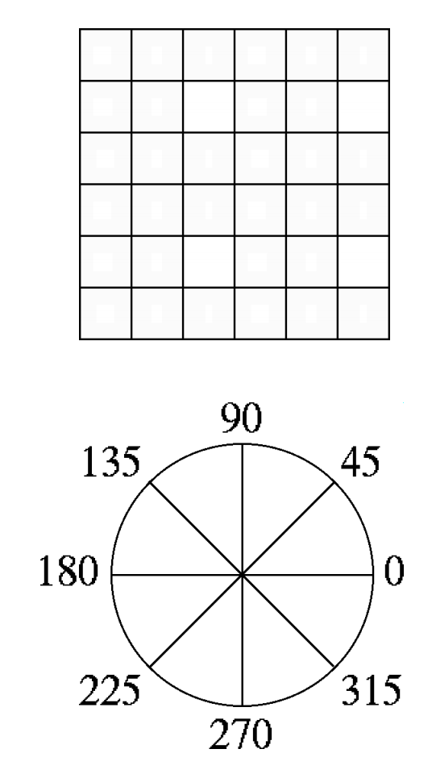
Histogram of Oriented Gradients
Step 0 (optional): image normalization (e.g. by taking square root).
Step 1: calculating the histogram
Dividing the image window into small spatial regions (cells)
Cells can be either rectangle or radial.
Each cell accumulating a weighted local 1-D histogram of gradient directions over the pixels of the cell.

Slide 13
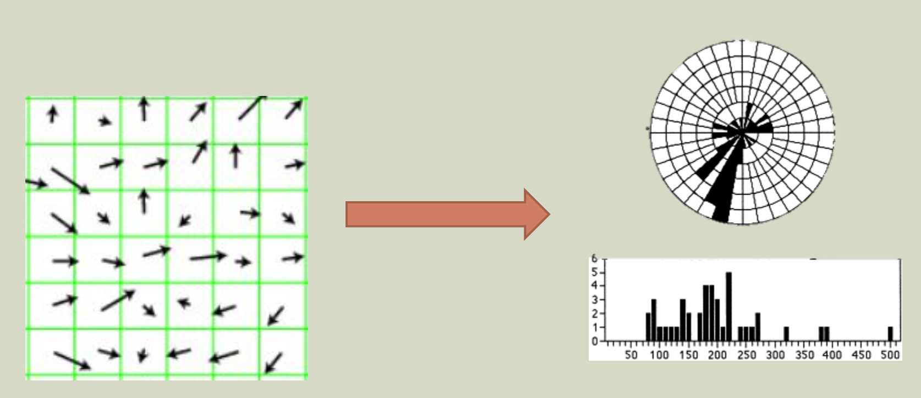
Histogram of Oriented Gradients
Step 1: calculating the histogram by weighted voting

Slide 14
Histogram of Oriented Gradients
https://customers.pyimagesearch.com/wp-content/uploads/2015/03/hog_contrast_normalization.gif

Slide 15
Normalization
Step 2: contrast normalization. The idea: achieve better invariance to illumination and shadowing.
Concat histograms in a block
Calculate the norm (e.g. L1)
Divide histograms in a cell by this norm
It will give as several final histograms for every cell as blocks are usually overlapping!
https://customers.pyimagesearch.com/wp-content/uploads/2015/03/hog_contrast_normalization.gif

Slide 16
Normalization
Step 2: contrast normalization. The idea: achieve better invariance to illumination and shadowing.
Concat histograms in a block
Calculate the norm (e.g. L1)
Divide histograms in a cell by this norm
It will give as several final histograms for every cell as blocks are usually overlapping!
Step 3: flatten all normalized histograms to get the final feature vector
https://customers.pyimagesearch.com/wp-content/uploads/2015/03/hog_contrast_normalization.gif

Slide 17
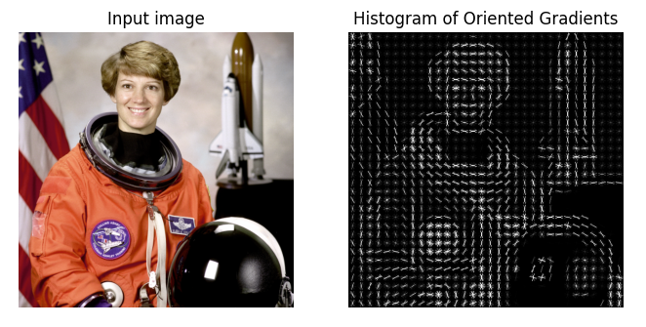
Visualizing HoG
https://scikit-image.org/docs/dev/auto_examples/features_detection/plot_hog.html

Slide 18
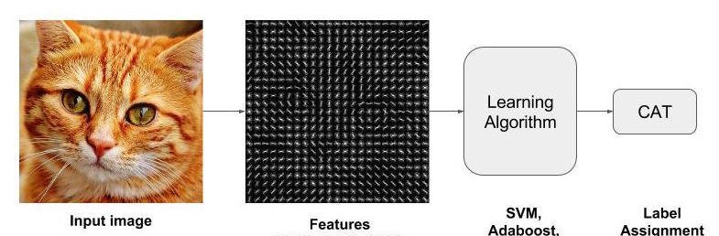
How can we use HOG to classify images?
Source

Slide 19
How can we use HOG to detect objects?
Image source: https://github.com/matterport/Mask_RCNN

Slide 20
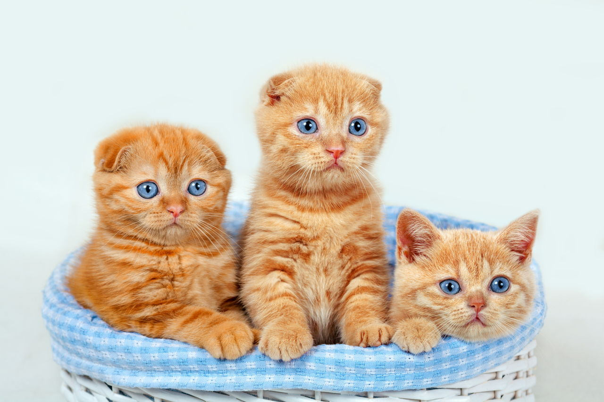
HOG for object detection
Step 1: sample positive and negative examples
Step 2: train a classifier
https://catappy.com/facts-about-orange-tabby-cat

Slide 21
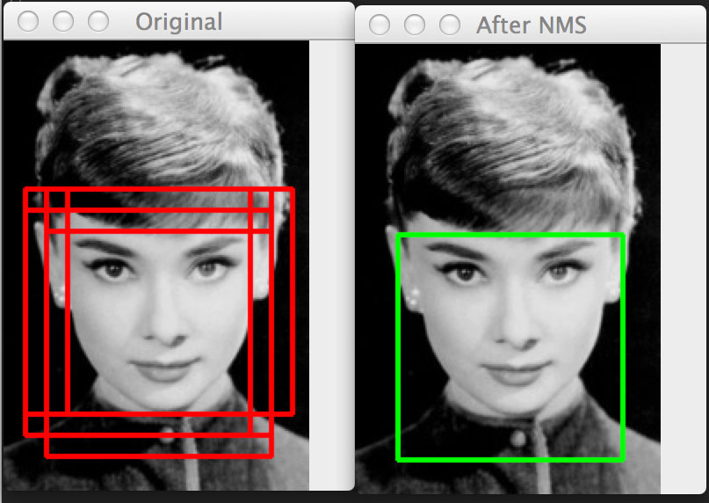
HOG for object detection
Step 1: sample positive and negative examples
Step 2: train a classifier Step 3: apply in a moving window
https://www.pyimagesearch.com/2014/11/10/histogram-oriented-gradients-object-detection/

Slide 22
HOG for object detection
Step 1: sample positive and
negative examples
Step 2: train a classifier Step 3: apply in a moving window
Step 4: apply NMS!
https://www.pyimagesearch.com/2014/11/10/histogram-oriented-gradients-object-detection/

Slide 23
HOG for object detection
Step 1: sample positive and
negative examples
Step 2: train a classifier Step 3: apply in a moving window
Step 4: apply NMS!
Step 1-3*: hard negative mining
Repeat steps 1-3 using False Positives as new negative samples
https://www.pyimagesearch.com/2014/11/10/histogram-oriented-gradients-object-detection/

